Slide 1
AI TRAINING HUB · WORKSHOP
Build Your First AI Agent
Danish Dhamani
120-minute hands-on workshop
Hands-on · Build as we go
Notes:
BEFORE YOU BEGIN:
Queue the deck on slide 1. Confirm Make.com is loaded in a tab and the lead form is ready. Have the backup workflow ready in case the live demo breaks.
SAY / DO:
Welcome everyone in. Set the frame clearly: this is a hands-on workshop, not a theory lecture. Tell them: we are going to build one system, three times, getting smarter each time. Basic automation, then an AI workflow, then an agent. Same use case throughout so their brain doesn't have to keep switching contexts.
Key line, say it out loud: 'Today, we're going to stop talking about automation and actually build one.'
HOOK / QUESTION:
Quick show of hands — 'who here has tried to build an automation before, even a simple one?' Don't dwell. Just take the temperature of the room.
⏰ TIME CHECK: 3 minutes. Do not run long here. The energy is in building, not in framing.

Slide 2
Today's Plan
Three rounds. I show one, you build one.
🕐 2 hours
ROUND 1
ROUND 2
ROUND 3
Automation
AI workflow
Agent
Build a workflow that runs itself. Fixed steps, same order, every time.
Same workflow — but one step in the middle uses AI to read and decide.
Give it a goal and some tools. It chooses the steps itself.
💬
Where does a chatbot fit? It doesn't — a chatbot waits for you to ask. Everything on this slide runs without you in the room. That's the whole point.
Notes:
BEFORE YOU BEGIN:
Nothing to set up. This is a pacing slide. Detailed minute-by-minute pacing lives in the appendix — keep that for yourself.
SAY / DO:
Two hours. Three rounds. Each round is the same shape: I show you one, you build one.
Say the key line: 'You don't need a perfect build today. You need to understand the pattern.'
Point at the three rounds and name what changes each time — round one the steps are fixed, round two AI does one step, round three the agent picks its own steps. Same workflow the whole way through.
Definitions:
Automation: fixed steps in a fixed order. No thinking involved. A washing machine cycle.
AI workflow: same fixed path, but one step in the middle uses AI to interpret something. Like a washing machine that can tell the difference between whites and darks.
Agent: a goal-driven system. You give it a goal, some tools, and some boundaries. It figures out the path. Like asking someone to do your laundry — they make the decisions.
Do NOT call agents magic. They are not. They are flexible workflows with decision-making.
HOOK / QUESTION:
'Which of these three have you heard of before? Which feels fuzzy?' Take a quick read.
⏰ TIME CHECK: 2 minutes. Do not linger.

Slide 3
What Should You Automate?
Three signals to look for.
🔁
📐
😩
Repetitive
Low Judgment
Friction
Happens at least weekly with the same shape
An intern could follow written instructions
It's annoying, slow, forgotten, or wasteful
💡
Shortcut: Start with the task you'd be relieved to never do again. You'll score your candidates properly in a moment.
Notes:
BEFORE YOU BEGIN:
Nothing.
SAY / DO:
This is the filter for choosing what to automate. Three signals: it repeats, it doesn't need much judgment, it annoys you.
Key line: 'If it happens often, takes time, and annoys you, it's probably worth automating.'
Examples: copying form responses into a sheet (yes — repetitive, low judgment, annoying). Writing a quarterly strategy doc (no — high judgment, infrequent). Sending a 'thanks for booking' email (yes). Resolving a customer escalation (no, not yet).
HOOK / QUESTION:
'What's a task in your week that hits all three?' Just let people think. Don't force shares.
⏰ TIME CHECK: 3 minutes.

Slide 4
Do Not Automate Chaos
If you can't write the steps down, you can't automate them.
✅ Automate this
⚠️ Fix the process first
·
The steps are the same every time Sending the confirmation email
·
You'd decide it differently each time Negotiating a price
·
The inputs arrive in a fixed shape A form with the same five fields
·
Nobody agrees on the current process "It depends who's covering that week"
·
A mistake is cheap to undo A duplicate row in a sheet
·
A mistake costs you the relationship Replying to a complaint
·
It happens weekly or more Twenty leads a week, not two a year
·
It has happened twice, ever Annual board reporting
The test: explain the task to a new hire in three sentences. If you can't, automating it will just make the mess run faster.
Notes:
BEFORE YOU BEGIN:
Nothing.
SAY / DO:
This is the counterweight to the last slide. Some things are NOT good first automations.
Do not automate: anything emotionally sensitive, anything where the wrong answer is costly, anything that's chaotic and undocumented, anything that requires real judgment.
Example: automate a confirmation email — good. Automate a customer negotiation — bad, at least until you've ridden along with the AI for a while.
The biggest mistake people make: they pick the most impressive process to automate first. Don't. Pick the most annoying small one. Win quickly. Build trust.
HOOK / QUESTION:
'Has anyone been burned by automating something too early?' Sometimes you get a great story here.
⚠️ COMMON MISCONCEPTION: That automation 'replaces' judgment. It moves judgment to design time — you decide once, the system executes many times. Bad inputs to that decision = bad system.
⏰ TIME CHECK: 4 minutes.

Slide 5
✍️ Activity — What Repeats in Your Week?
🕐 5 minutes
List three repetitive tasks, then score each 1–5. Multiply to find your best automation target.
Task
Frequency How often?
Time How long?
Annoyance How much?
Score F × T × A
1
2
3
💬
Pick the highest score. That's your automation target for today.
Notes:
BEFORE YOU BEGIN:
Keep this low-pressure. People freeze on reflection slides if you make it feel like a test.
SAY / DO:
Five minutes. Open a doc, a notebook, whatever. Write three repetitive things you do in a typical week. Not three impressive things. Three annoying ones.
Prompt them: 'Don't pick the most impressive task. Pick the one that annoys you most.'
Walk the room while they write. Read over a few shoulders. Note anyone who finishes fast — you'll call on them.
HOOK / QUESTION:
After four minutes: 'Who'll share one?' Get 2 to 3 voices. Don't grade their answers — just acknowledge.
⏰ TIME CHECK: 5 minutes. If running behind, give 3 minutes and skip the share.

Slide 6
Our Shared Use Case
Lead capture — every business has a version of this.
STEP 1
📨
Form submitted
Someone reaches out
STEP 2
📊
Store the lead
Why one example? So your brain doesn't have to keep switching contexts.
Sheet, CRM, or DB
STEP 3
SWAP THE LABEL
Lead → applicant → student → customer. Same shape.
✉️
Send confirmation
Sender knows they're seen
STEP 4
🔔
Notify the team
Someone follows up
Notes:
BEFORE YOU BEGIN:
This is the shared example we will use for the rest of the workshop. Land it.
SAY / DO:
We are using lead capture as our shared use case. Why? Because every business has some version of it. Form submission, store the lead somewhere, send a confirmation back, notify the team.
Key line: 'We're using one example so your brain doesn't have to keep switching contexts.'
If they don't have a lead form in their business, tell them to imagine it as 'someone reaches out, we capture, we respond, we follow up.' Same shape, different label.
HOOK / QUESTION:
'What does this look like in your world? Job applications? Volunteer signups? Support requests?' Quick share.
⏰ TIME CHECK: 3 minutes.

Slide 7
Every Workflow Has a Shape
Before tools, we need clarity.
TRIGGER
What starts the workflow?
INPUTS
What data comes in?
STEPS
What happens in order?
OUTPUT
What do you get at the end?
CHECK-IN
"In our lead example — what's the trigger?"
Notes:
BEFORE YOU BEGIN:
Get ready to draw on the board, or just walk through the four boxes on screen.
SAY / DO:
Before we open any tool, we map the workflow. Four parts.
Trigger: what starts it? (Form submission)
Inputs: what data comes in? (Name, email, message)
Steps: what happens, in order? (Store, email, notify)
Output: what does success look like? (Lead saved, team alerted, sender confirmed)
Key line: 'Before tools, we need clarity.'
HOOK / QUESTION:
'In our lead example — what's the trigger?' Get them to say 'form submission.' Then 'what are the inputs?' Walk it together.
⚠️ COMMON MISCONCEPTION: People skip mapping and go straight to the tool. Then they get stuck halfway, because they didn't decide what 'done' meant.
⏰ TIME CHECK: 5 minutes.

Slide 8
Workflow Map: Lead Capture
In plain English first. Tools second.
TRIGGER
A new lead form submission comes in
INPUTS
STEP 1
STEP 2
STEP 3
OUTPUT
Notes:
BEFORE YOU BEGIN:
Nothing.
SAY / DO:
Walk slowly through each row. This is the workflow we're about to build, written in plain English.
Trigger: someone submits the lead form.
Inputs: name, email, message, source.
Steps: append a row to the sheet, send a confirmation email, post to Slack.
Output: the team has a logged, acknowledged lead.
Key line, say it: 'If you can explain it in plain English, you can build it.'
Transition: 'Now that we can explain it, we can build it. Let's open Make.com.'
HOOK / QUESTION:
'Anything missing from this map?' Often someone says 'tag the lead' or 'check for duplicates.' Acknowledge — say we'll add complexity later.
⏰ TIME CHECK: 5 minutes.

Slide 9
Workflow Map: Lead Capture
In plain English first. Tools second.
TRIGGER
A new lead form submission comes in
INPUTS
Name, email, message
STEP 1
STEP 2
STEP 3
OUTPUT
Notes:
BEFORE YOU BEGIN:
Make.com open, lead form open in another tab, sheet ready. Run a test once before learners arrive.
SAY / DO:
Fifteen minutes. Live demo. Narrate WHY each piece exists, not every click.
Start with the trigger — connect to the form. Talk about how a trigger is a sensor: it just waits and listens.
Then the first action — append to sheet. Show the field mapping. Say: 'this is where most automations live or die — the data shape.'
Then the notify step — Slack or email to you. Note: we're keeping this demo to two actions so the shape stays clear. The confirmation-to-sender step is something they can add in practice.
Run a test. Show the row appearing. Show the notification arriving.
Key line: 'Trigger starts it. Actions do the work.'
HOOK / QUESTION:
Mid-demo: 'What's the trigger? What's the action?' Make them name parts as you build.
⚠️ COMMON MISCONCEPTION: People conflate trigger and action. The trigger is the sensor. Actions are the limbs.
⏰ TIME CHECK: 10–15 minutes. If running over, cut to the sheet step only.

Slide 10
Workflow Map: Lead Capture
In plain English first. Tools second.
TRIGGER
A new lead form submission comes in
INPUTS
Name, email, message
STEP 1
Add a row to the sheet
STEP 2
STEP 3
OUTPUT
Notes:
BEFORE YOU BEGIN:
Only use this slide if the demo breaks. Have a screenshot of a working build ready in another tab.
SAY / DO:
If the live build breaks, do not troubleshoot for more than two minutes. Switch to the backup. Show a screenshot or pre-built version. Walk through it as if you'd just built it.
Reassure: 'Real builds break. That's part of the work. The pattern still applies.'
Get back to the demo flow as fast as possible. Don't apologize at length.
HOOK / QUESTION:
None. This is recovery, not teaching.
⏰ TIME CHECK: Max 2 minutes of troubleshooting before switching to backup.

Slide 11
Workflow Map: Lead Capture
In plain English first. Tools second.
TRIGGER
A new lead form submission comes in
INPUTS
Name, email, message
STEP 1
Add a row to the sheet
STEP 2
Send a confirmation to the lead
STEP 3
OUTPUT
Notes:
BEFORE YOU BEGIN:
Make sure everyone has Make.com open and a test form they can use. Have a help signal — sticky on the laptop, or a Slack channel.
SAY / DO:
Fifteen minutes. Their turn. Build one trigger, two actions, and run one successful test.
Walk the room. Ask one question to anyone who looks stuck: 'What starts your workflow? What should happen next?'
Fast learners: have them add a third action, or personalize the confirmation email with the lead's name.
Do NOT solve it for them. Ask, point, leave.
Key line, repeat as you walk: 'One trigger, two actions, one test run. That's the win.'
HOOK / QUESTION:
Last two minutes: 'Who got a test to run?' Quick raised hands. Celebrate the firsts.
⏰ TIME CHECK: 15 minutes. Hard stop. The debrief is where the learning lands.

Slide 12
Workflow Map: Lead Capture
In plain English first. Tools second.
TRIGGER
A new lead form submission comes in
INPUTS
Name, email, message
STEP 1
Add a row to the sheet
STEP 2
Send a confirmation to the lead
STEP 3
Email a notification to my team
OUTPUT
Notes:
BEFORE YOU BEGIN:
Nothing.
SAY / DO:
This is the value moment. Have them name what changed.
Ask: 'Before this workflow, this task took you how long, and how often did you do it?' Then: 'After this workflow, what part now happens without you?'
Let them feel the leverage. Five hours a week of manual copying becomes zero. That's the unlock.
Key line: 'Automation moves work off your plate. AI will move thinking off your plate. We're stacking them.'
Transition: 'Now we'll make it smarter.'
HOOK / QUESTION:
'What part of your process now happens without you?'
⏰ TIME CHECK: 5 minutes. Don't skip — this is where motivation is built.

Slide 13
Workflow Map: Lead Capture
In plain English first. Tools second.
TRIGGER
A new lead form submission comes in
INPUTS
Name, email, message
STEP 1
Add a row to the sheet
STEP 2
Send a confirmation to the lead
STEP 3
Email a notification to my team
OUTPUT
Lead is logged, confirmed, and team notified
Transition: If you can explain it in plain English, you can build it.
Notes:
BEFORE YOU BEGIN:
Nothing.
SAY / DO:
Introduce AI as a step inside the workflow. Not a replacement — a step.
AI does four jobs well in workflows:
Summarize — turn long input into short output.
Classify — pick a category from a list.
Extract — pull specific fields out of messy text.
Draft — produce new text from a template.
Key line: 'Automation moves data. AI interprets data.'
For the lead workflow: AI will read the inquiry, summarize it in one sentence, classify intent as high/medium/low, and explain why.
⚠️ COMMON MISCONCEPTION: People want AI to do everything in one step. Don't. One narrow task per AI step.
⏰ TIME CHECK: 5 minutes.

Slide 14
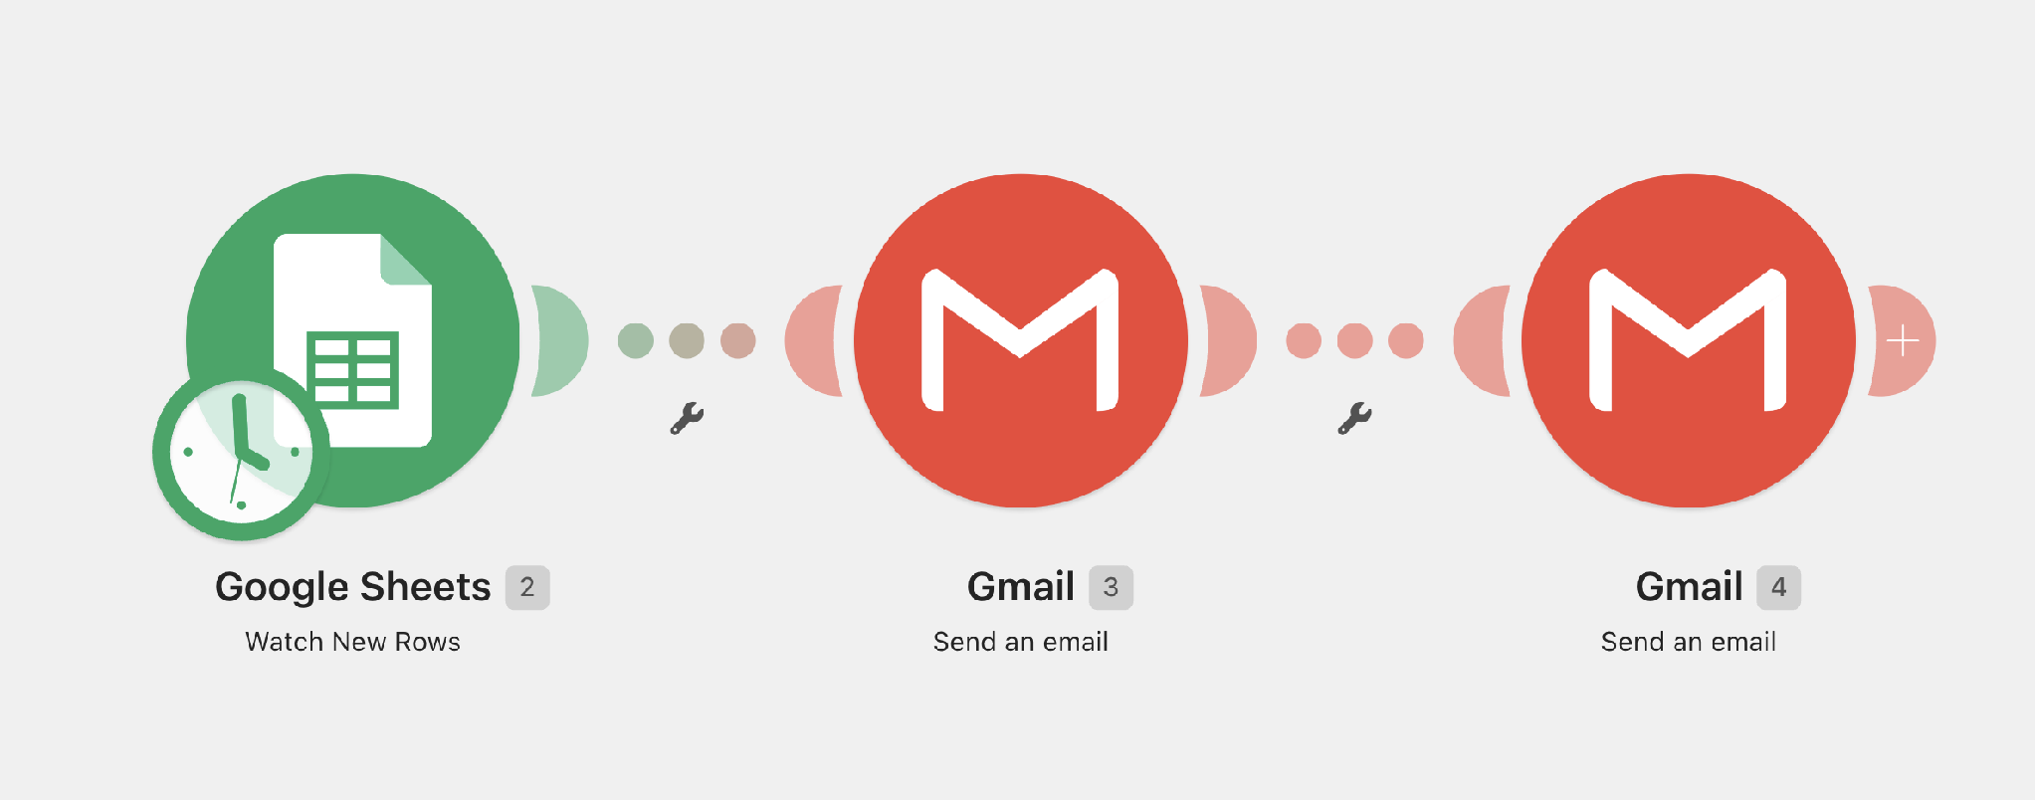
LIVE DEMO · 5 MINUTES
Demo 1 — The Basic Automation
Trigger starts it. Actions do the work.
Notes:
BEFORE YOU BEGIN:
Make.com open with the basic workflow from Demo 1. Have your AI prompt copied to a sticky note.
SAY / DO:
Fifteen minutes. Add one AI step to the existing workflow.
Show them: between 'capture form' and 'append to sheet,' insert an AI step. Paste in a narrow prompt.
Prompt example, read it out:
'Summarize this inquiry in one sentence. Classify lead intent as High, Medium, or Low. Explain why in one line.'
Show the output. Show how it gets piped into the sheet as new columns: summary, score, reasoning. Now also show: when the score is High, draft a reply; when Low, just log and move on.
Key line: 'Keep the AI task narrow. One job. Specific output format.'
HOOK / QUESTION:
'What would you ask the AI to do with your data?'
⚠️ COMMON MISCONCEPTION: Vague prompts. 'Tell me about this lead' is bad. Specific output format and length is good.
⏰ TIME CHECK: 15 minutes.

Slide 15
🛠 Practice 1 — Your First Automation
🕐 20 minutes
Stuck? Ask yourself two questions: What starts the workflow? What should happen next?
Notes:
BEFORE YOU BEGIN:
Nothing.
SAY / DO:
Shift gears. We've done automation and AI workflow. Now agents.
The difference is small in words but big in behavior. A workflow follows a path you defined. An agent pursues a goal you defined, choosing the path itself.
Key line: 'An agent is not magic. It's a flexible workflow with decision-making.'
Example: a workflow you'd describe as 'first do A, then B, then C.' An agent you'd describe as 'achieve outcome X — here are tools and rules.'
⚠️ COMMON MISCONCEPTION: People expect agents to be smart in general. They are only as good as the goal, the tools, and the boundaries you give them.
⏰ TIME CHECK: 4 minutes.

Slide 16
Debrief: You Just Built One
Turn to a neighbour. Two minutes each.
🔨
🧱
⚡
What did you build?
Where did you get stuck?
What did the test run feel like?
Say your trigger and your actions out loud, in one sentence.
Connecting an account? Picking the trigger? Mapping a field?
The moment the email actually landed — what did that change for you?
The real takeaway: the hard part was never the tool. It was deciding what starts the workflow and what should happen next.
TRANSITION
Automation moves work off your plate. Now we'll move thinking off your plate too.
Notes:
BEFORE YOU BEGIN:
Nothing.
SAY / DO:
Every useful agent has four things. Read them.
Goal — what success looks like, narrow and measurable.
Tools — what it can do (look up, send, write, search).
Instructions — how to behave (tone, format, what not to do).
Boundaries — when to stop and ask a human.
Give the good/bad goal example. Bad: 'Help with sales.' Better: 'Evaluate inbound leads and draft a personalized response for human review.'
Key line: 'Narrow agents work better than smart-sounding agents.'
HOOK / QUESTION:
'What's a goal you've given an AI that was too vague?' Quick share if time.
⏰ TIME CHECK: 4 minutes.

Slide 17
Add AI to the Workflow
AI is a step, not a replacement.
📝
🏷️
🔎
✍️
Summarize
Classify
Extract
Draft
Long input into a short, useful output
Pick one label from a list you defined
Pull specific fields out of messy text
Write new text from a template & inputs
MANTRA
Automation moves data. AI interprets data.
Notes:
BEFORE YOU BEGIN:
If running tight, have a pre-built version of this agent. Don't try to build it live in under 8 minutes.
SAY / DO:
Show the agent version. Same use case — lead capture.
Walk through behavior: it reads the inquiry, looks up the company, evaluates fit against criteria you defined, drafts a reply in your voice, and explains why. Then it waits for you to approve.
Emphasize two things — human review and narrow scope. The agent never sends. It always asks.
Key line: 'Humans approve. Agents execute. That's the contract.'
HOOK / QUESTION:
'What would you trust this agent to do without review? What would you not?'
⚠️ COMMON MISCONCEPTION: That an agent saves time only if it acts autonomously. Wrong — a draft-only agent already saves enormous time. Approval is the cheap part.
⏰ TIME CHECK: 8 minutes if compressed, up to 12 if extending.

Slide 18
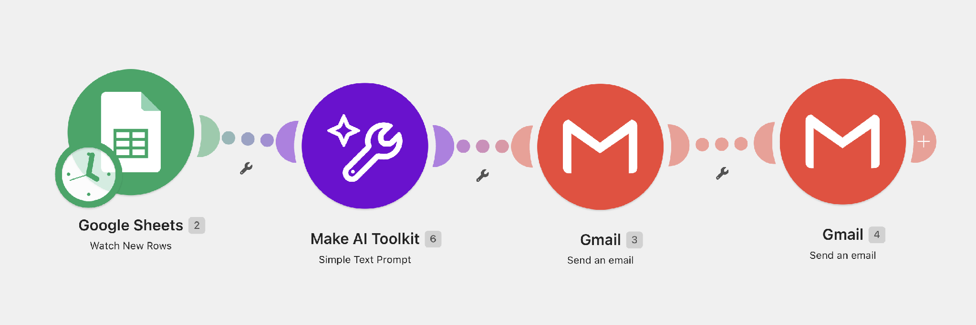
LIVE DEMO · 5 MINUTES
Demo 2 — Add AI Summary & Classification
The automation handles structure. AI handles the flexible thinking inside it.
Notes:
BEFORE YOU BEGIN:
Scope first, then build. The capstone is to ship the narrowest useful version, not just sketch one.
SAY / DO:
Fifteen to eighteen minutes. They scope the agent — Goal, Tools, Instructions, Boundaries, Output — then build the simplest version and run one test case.
Key line, say it twice: 'Keep the first agent narrow. One goal, few tools, draft only.'
Walk. Read over shoulders. The most common mistake is the goal being too broad. Push them to narrow.
Less advanced rooms: a fully scoped canvas plus a started build is a win — don't force a finished agent.
HOOK / QUESTION:
Final minute: 'Who has a goal sentence they're proud of? Read it.'
⏰ TIME CHECK: 15–18 minutes (1:37–1:55).

Slide 19
🛠 Practice 2 — Add One AI Step
🕐 10 minutes
Notes:
BEFORE YOU BEGIN:
This is the responsibility moment. Land it.
SAY / DO:
Three maturity levels.
Early: agent drafts only. Human approves every output. This is where you start. Always.
Maturing: agent suggests actions. Human reviews edge cases — high stakes, low confidence, unusual cases.
Trusted: agent runs low-risk actions automatically. Logs everything. Human reviews weekly.
Boundary rule, read it out: 'Always require human review for anything involving money, customers, health, legal, or reputation.'
Key line: 'Trust is earned by observation, not promised by the vendor.'
HOOK / QUESTION:
'What level would you trust your agent at today?'
⚠️ COMMON MISCONCEPTION: That you graduate the agent by giving it more freedom. You graduate it by watching it succeed, repeatedly, in narrow cases.
⏰ TIME CHECK: Use if you have time. Otherwise compress to the boundary rule only.

Slide 20
Debrief: What Did AI Change?
Same neighbour. Two minutes each.
🎯
🔍
✏️
What job did you give the AI?
Did the output hold up?
What would you change in the prompt?
Say it in one sentence — summarize, classify, draft, extract.
Too long? Too generic? Made something up? Be specific about what went wrong.
Usually it's one of two things: a tighter job, or a stated output format.
The real takeaway: the workflow didn't get smarter — one step did. The path is still fixed, and you still chose it.
TRANSITION
So what happens when nobody chooses the path in advance?
Notes:
BEFORE YOU BEGIN:
Nothing to set up. Debrief the AI round the same way you debriefed Round 1.
SAY / DO:
Pair them off again. Two minutes each, then pull three answers from the room.
The question that matters most is the second one — did the output hold up? Push for specifics. 'It was fine' is not an answer. Ask what it got wrong.
Expect at least one person to say the AI output was too long, too generic, or invented something. That is the lesson, not a failure. Narrow the prompt, name the format, and it improves.
Land the takeaway: the workflow did not get smarter. One step did. Everything around it is still fixed plumbing you control.
HOOK / QUESTION:
'Whose AI step got something wrong? Read us what it said.'
⏰ TIME CHECK: 5 minutes.

Slide 21
From Workflow to Agent
Same use case, different shape of system.
Workflow
Agent
·
You define the path
·
You define the goal
·
Each step is fixed
·
It chooses the steps
·
Predictable, repeatable
·
Flexible within boundaries
·
"First A, then B, then C"
·
"Achieve X — here are tools"
DEMYSTIFY
An agent is not magic. It's a flexible workflow with decision-making.
Notes:
BEFORE YOU BEGIN:
Nothing.
SAY / DO:
Five to seven minutes. Two or three volunteers share what they built.
Ask each one three things, in order: What did you build? Where did AI help? What would you improve next?
Keep each share to about two minutes. Celebrate specifics, not effort.
If running behind, take one share only, or skip.
HOOK / QUESTION:
'Who'll go first?' If silence, call on someone you noticed during practice.
⏰ TIME CHECK: 5–7 minutes. Skippable if needed.

Slide 22
Agent Anatomy
Four parts every useful agent has.
+
+
+
🎯 Goal
🛠 Tools
📋 Instructions
🚧 Boundaries
What success looks like — narrow and measurable
What it can do — look up, send, write, search
How to behave — tone, format, what to avoid
When to stop and ask a human
GOAL TEST
Bad: "Help with sales." Better: "Evaluate inbound leads and draft a personalized reply for human review."
Notes:
BEFORE YOU BEGIN:
This is the close. Slow down.
SAY / DO:
Four things to remember, in order.
Automate repetition. The annoying small thing first, not the impressive big thing.
Map before tools. Plain English first, then click anything.
Add AI narrowly. One job per step. Specific output format.
Agentize only when flexibility matters. If a workflow can do it, don't reach for an agent.
Final action — this week, pick one real workflow and build the simplest useful version. Not the complete version. The simplest useful one.
Key line: 'You don't need a perfect build. You need a started one.'
HOOK / QUESTION:
'What's the one workflow you'll build this week?' Let it sit. Don't force shares.
⏰ TIME CHECK: 3 minutes.

Slide 23
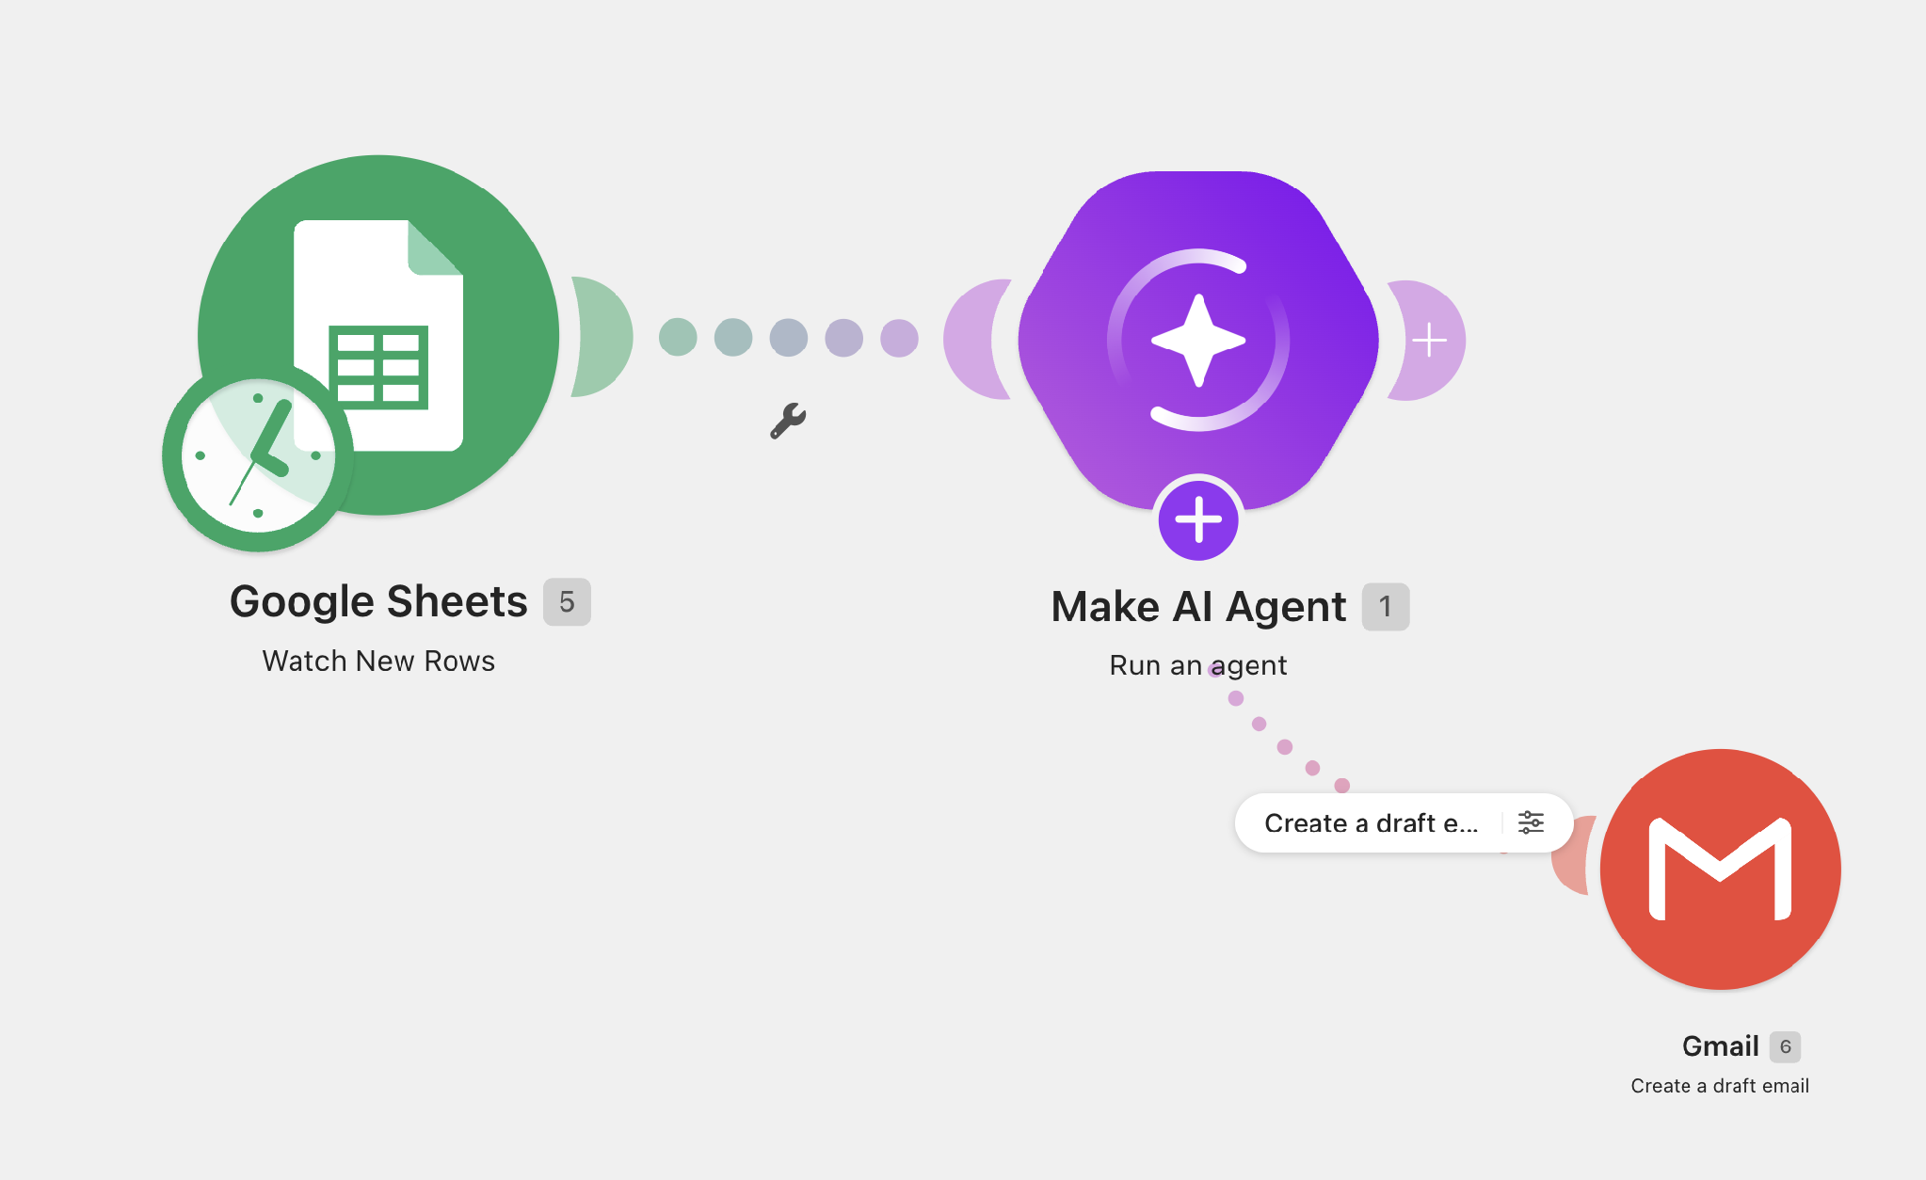
LIVE DEMO · 5 MINUTES
Demo 3 — Build Your First Agent
Turn the workflow into a narrow agent — without making it dangerously broad.
GOAL: Evaluate inbound leads and draft personalized replies. TOOLS: Lead form data · Google Sheets · web research · email draft. BOUNDARIES: Draft only — never send. Ask a follow-up if information is missing. OUTPUT: Fit assessment · reason · draft reply · recommended next step.
Notes:
BEFORE YOU BEGIN:
This is an appendix. Point learners here during Practice 2 if they're stuck on prompts.
SAY / DO:
During the workshop, don't present this slide. Reference it. Tell learners: 'If you don't know how to write the AI step, the appendix has eight prompts you can copy and adapt.'
After the workshop, send this slide as a follow-up.
The four AI jobs each have two ready prompts. They're written narrow on purpose.
HOOK / QUESTION:
None. Reference slide.
⏰ TIME CHECK: Backup / support only.

Slide 24
🛠 Practice 3 — Build Your First Agent
🕐 15 minutes
GOAL: What outcome do you want the agent to achieve? TOOLS: What can it look up, write, or send? BOUNDARIES: Draft only. When should it stop and ask? OUTPUT: What does it hand back to the human?
Notes:
BEFORE YOU BEGIN:
Appendix for trainer reference.
SAY / DO:
Use this if you need to re-explain an activity to a learner mid-room. The three practice activities are written here at a glance, with success criteria and the fast-learner extension.
Reminder: Practice 3 is design-first. Building is a stretch goal, not the requirement. If a learner is upset they didn't build the agent, redirect — a clear canvas is the win.
HOOK / QUESTION:
None. Reference slide.
⏰ TIME CHECK: Backup / support only.

Slide 25
Keep Humans in the Loop
Trust is earned by observation, not promised by the vendor.
STAGE 1 · EARLY
STAGE 2 · MATURING
STAGE 3 · TRUSTED
Draft only
Suggest & review
Act & log
Agent proposes. Human approves every output. Always start here.
Agent acts on routine cases. Human reviews edge cases — low confidence, high stakes.
Agent runs low-risk actions automatically. Logs everything. Human reviews weekly.
BOUNDARY RULE
Always require human review for money, customers, health, legal, or reputation.

Slide 26
Debrief: What Did the Agent Decide?
Same build, different experience. Two minutes each.
🧭
🤝
📌
What did it decide on its own?
Would you let it send?
Where would you point it next?
Point to the moment it did something you never explicitly scripted.
Be honest. What would have to be true before you'd take your hand off it?
One task in your own week that fits this shape.
The real takeaway: you wrote fewer steps this round, not more. You described a goal and handed over the path.
TRANSITION
Which raises the only question that matters: when does a human stay in the loop?
Notes:
BEFORE YOU BEGIN:
Everyone built the same agent, so do not run a show-and-tell. Debrief the experience, not the artifact.
SAY / DO:
Pair discussion first, two minutes each, then pull answers from the room.
Question one is the whole point of the round. Push for the moment they noticed the agent doing something they did not explicitly script — choosing what to look up, deciding what to say, deciding to stop.
Question two surfaces the trust problem. Expect 'I would not let it send.' Good. That is the right instinct and it sets up the humans-in-the-loop slide.
Question three is the transfer question. If they cannot name a task, they will not build again on Monday.
Land the takeaway: they did not write more steps this round — they wrote fewer, and described a goal instead.
HOOK / QUESTION:
'Did your agent do anything you did not tell it to do?'
⏰ TIME CHECK: 5–7 minutes.

Slide 27
What to Remember
Four ideas to take with you.
🔁
Automate repetition
Annoying small tasks first. Impressive ones later, with more confidence.
🗺️
Map before tools
Plain English first, then click anything. Clarity is the cheapest debug.
🎯
Add AI narrowly
One job per step. Specific output format. Pipe results downstream.
🤖
Agentize only when flexibility matters
If a workflow can do it, don't reach for an agent. Start with draft-only.
THIS WEEK
Pick one real workflow. Build the simplest useful version.

Slide 28
Appendix — AI Step Prompt Pack
Copy, narrow, and paste into your AI step.
Reference
📝 SUMMARIZE
📝 SUMMARIZE
Inquiry summary
Meeting recap
Summarize this inquiry in one sentence under 20 words.
Summarize this transcript as 3 bullets: decisions, owners, next steps.
🏷️ CLASSIFY
🏷️ CLASSIFY
Lead intent score
Support ticket type
Classify lead intent as High, Medium, or Low. Output only the label.
Pick one category: Billing, Bug, Feature, Other. Output only the label.
✍️ GENERATE
✍️ GENERATE
Confirmation reply
Internal heads-up
Draft a 3-sentence reply thanking {{name}} and promising follow-up within 1 business day.
Write a 1-sentence Slack message alerting the team about this new lead and why it matters.
🔎 EXTRACT
🔎 EXTRACT
Contact fields
Deal signals
Extract name, email, company, role as JSON. Use null if a field is missing.
List any mentions of budget, timeline, or decision-makers as bullets.

Slide 29
Appendix — Activity Reference
Quick reset card if you lose the thread.
Reference
PRACTICE 1
PRACTICE 2
PRACTICE 3
First automation
Add one AI step
Scope & build the agent
One trigger, two actions, one successful test run.
Pick one AI job. Output must flow into a later step.
Goal, tools, instructions, boundaries, output — then build the narrowest version.
Stretch: Third action or personalized email.
Stretch: Conditional routing by classification.
Submit: one test case + screenshot or link.
⚠️
Golden rule: Keep your first agent narrow — draft only, never auto-send. One goal, few tools, clear output.

Slide 30
Appendix — Detailed Run of Show
Minute-by-minute pacing reference.
Reference
0:00 – 0:10
Frame, mental model & shared use case
0:10 – 0:22
🖊 Activity — find your automation target
0:22 – 0:38
Map the lead capture workflow
0:38 – 0:43
⚡ Demo 1 — basic automation in Make.com
0:43 – 1:05
🛠 Practice 1 — build & test your first automation
1:05 – 1:35
⚡ Demo 2 + 🛠 Practice 2 — add one AI step
1:35 – 1:45
Agents — what they are & how they're scoped
1:45 – 2:00
⚡ Demo 3 + 🛠 Practice 3 — scope & build the agent
At close
Humans in the loop · share-out · takeaways
Notes:
BEFORE YOU BEGIN:
Nothing to set up. This is a pacing slide.
SAY / DO:
Tell them the workshop is fast. Two hours. We move. We don't try to make it perfect — we make it work and we make it understandable. They will leave with a built thing, not a polished thing.
Key line, say it: 'You don't need a perfect build today. You need to understand the pattern.'
Walk through the agenda blocks: frame &amp; find candidates (0:00–0:22), map the workflow (0:22–0:38), build the automation (0:38–0:58), add one AI step (1:03–1:22), explain agents and the capstone (1:22–1:55), wrap (1:55–2:00). Demos and practice alternate so they always do, not just watch.
HOOK / QUESTION:
'Anyone need to step out before we start? Now's the moment.'
⏰ TIME CHECK: 3 minutes max. Don't read every row.

